Slide 1
Romans 14

Slide 2
14 As for the one who is weak in faith, welcome him, but not to quarrel over opinions. ² One person believes he may eat anything, while the weak person eats only vegetables. ³ Let not the one who eats despise the one who abstains, and let not the one who abstains pass judgment on the one who eats, for God has welcomed him. ⁴ Who are you to pass judgment on the servant of another? It is before his own master that he stands or falls. And he will be upheld, for the Lord is able to make him stand.

Slide 3
⁵ One person esteems one day as better than another, while another esteems all days alike. Each one should be fully convinced in his own mind. ⁶ The one who observes the day, observes it in honour of the Lord. The one who eats, eats in honour of the Lord, since he gives thanks to God, while the one who abstains, abstains in honour of the Lord and gives thanks to God. ⁷ For none of us lives to himself, and none of us dies to himself. ⁸ For if we live, we live to the Lord, and if we die, we die to the Lord. So then, whether we live or whether we die, we are the Lord’s. ⁹ For to this end Christ died and lived again, that he might be Lord both of the dead and of the living.

Slide 4
¹⁰ Why do you pass judgment on your brother? Or you, why do you despise your brother? For we will all stand before the judgment seat of God; ¹¹ for it is written,
“As I live, says the Lord, every knee shall bow to me,
and every tongue shall confess to God.”
¹² So then each of us will give an account of himself to God.
¹³ Therefore let us not pass judgment on one another any longer, but rather decide never to put a stumbling block or hindrance in the way of a brother. ¹⁴ I know and am persuaded in the Lord Jesus that nothing is unclean in itself, but it is unclean for anyone who thinks it unclean.

Slide 5
¹⁵ For if your brother is grieved by what you eat, you are no longer walking in love. By what you eat, do not destroy the one for whom Christ died. ¹⁶ So do not let what you regard as good be spoken of as evil. ¹⁷ For the kingdom of God is not a matter of eating and drinking but of righteousness and peace and joy in the Holy Spirit. ¹⁸ Whoever thus serves Christ is acceptable to God and approved by men. ¹⁹ So then let us pursue what makes for peace and for mutual upbuilding.

Slide 6
²⁰ Do not, for the sake of food, destroy the work of God. Everything is indeed clean, but it is wrong for anyone to make another stumble by what he eats. ²¹ It is good not to eat meat or drink wine or do anything that causes your brother to stumble. ²² The faith that you have, keep between yourself and God. Blessed is the one who has no reason to pass judgment on himself for what he approves. ²³ But whoever has doubts is condemned if he eats, because the eating is not from faith. For whatever does not proceed from faith is sin.

Slide 7
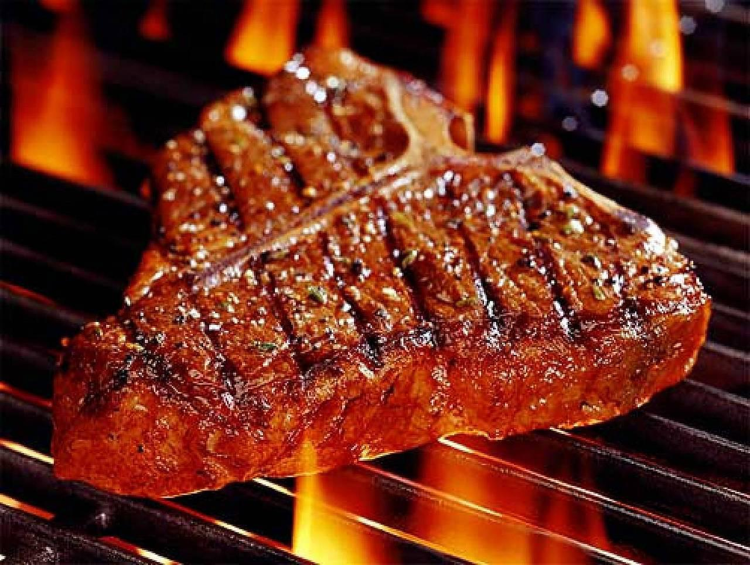
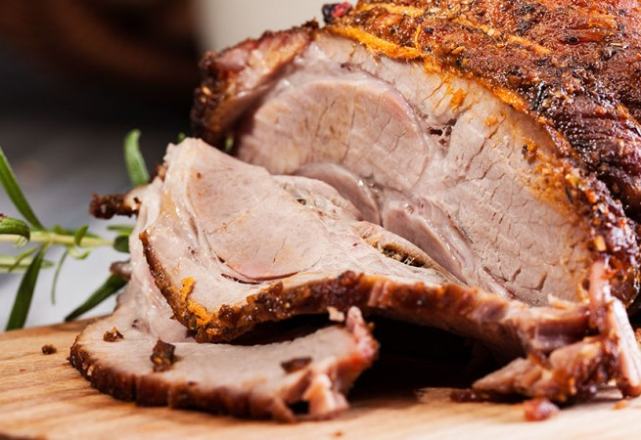

Slide 8
What are we free to do in Christ?
We are free in regard to religious practices / religious rules and regulations (such as cleanliness laws & Sabbath laws)
We should not judge one another in regards to religious rules
In Christ, is there anything we’re not free to do?
We are not free in regard to moral and ethical conduct
It is our duty to hold one another accountable (1 Cor 5)
The way we exercise our freedoms, impacts on our brothers and sisters in Christ
Example 1 : - The Sabbath (a compulsory day of rest)
Christians are not bound by the laws of the Sabbath
We are free to play sport and work on the Sabbath
But we are also free to keep the Sabbath & enjoy a day off
If I am convicted to keep a Sabbath, I shouldn’t expect everyone else to do the same

Slide 9
The way we exercise our freedoms, impacts on our brothers and sisters in Christ
Example 2 : - Alcohol (Is it a sin to drink alcohol?)
Drinking alcohol isn’t a sin. But getting drunk, is a serious sin.
In Christ, we are free to drink. But in some cases, we are not:
1. When the laws of the land prohibit it
2. When it is likely to lead to drunkenness
A personal line in the sand – when one is affected by it
3. When the Lord has convicted you to not drink
The convicted honour the Lord by abstaining
But don’t pass judgment on Christian brothers who don’t abstain
Those who do drink, should honour the one who doesn’t
4. When drinking may cause somebody else to stumble
Eg. An alcoholic present / others likely to get drunk

Slide 10
Drinking alcohol isn’t a sin. But getting drunk, is a serious sin.
In Christ, we are free to drink. But in some cases, we are not:
1. When the laws of the land prohibit it
2. When it is likely to lead to drunkenness
A personal line in the sand – when one is affected by it
3. When the Lord has convicted you to not drink
The convicted honour the Lord by abstaining
But don’t pass judgment on Christian brothers who don’t abstain
Those who do drink, should honour the one who doesn’t
4. When drinking may cause somebody else to stumble
Eg. An alcoholic present / others likely to get drunk
5. When it is putting a strain on my relationship with a Brother
¹⁵ If your brother is grieved by what you eat, you are no longer walking in love. By what you eat, do not destroy the one for whom Christ died.

Slide 11
What are we free to do in Christ?
We are free in regard to religious practices / religious rules and regulations (such as cleanliness laws & Sabbath laws)
We should not judge one another in regards to religious rules
In Christ, is there anything we’re not free to do?
We are not free in regard to moral and ethical conduct
It is our duty to hold one another accountable (1 Cor 5)
The way we exercise our freedoms, impacts on our brothers and sisters in Christ
Don’t judge others by your personal convictions
Be careful your freedom doesn’t cause others to stumble
Don’t let the exercise of your freedom grieve another.
Honour Christ in everything we do
¹⁷ The Kingdom of God is not a matter of eating and drinking, but of righteousness and peace and joy in the Holy Spirit. ¹⁸ Whoever thus serves Christ is acceptable to God and approved by men

